Slide 1



Patient Registration Process at KlinikGo
System Analyst | Project Based Intern | Rakamin Academy
Welcome to KlinikGo, where patient registration is made easy. Learn about the step-by-step process of registering online, selecting your preferred doctor, and choosing the right appointment time.
by Maulana Kavaldo

Slide 2




ABOUT ME
I’m have an interest in data science/analyst, machine learning, and cloud computing. Have knowledge of information technology, especially in the use of office software such as Microsoft Office, familiar with several programming languages, and data-related tools. I’m quick learner, meticulous, strong in detail and always trying to give the best in every job, communicate well and work together in a team. Top 10% of the best participants DTS KOMINFO FGA: Data Science.

Slide 3

Problem
KlinikGo aims to create a comprehensive system diagram illustrating the patient registration process on their web platform. The website enables patients to register online, select their preferred doctor, and choose a suitable appointment time.

Slide 4
Business Requirements
Form Filling
Registration Confirmation
Queue Number Printing
The form requires the entry of the medical record number (for returning patients), personal information, choice of doctor, preferred schedule, and a contactable WhatsApp number.
The system will send a registration confirmation, including a summary and barcode, to the provided WhatsApp number or email.
Patients are expected to arrive 1 hour prior to the examination, and they should print their queue number using the APM machine.

Slide 5
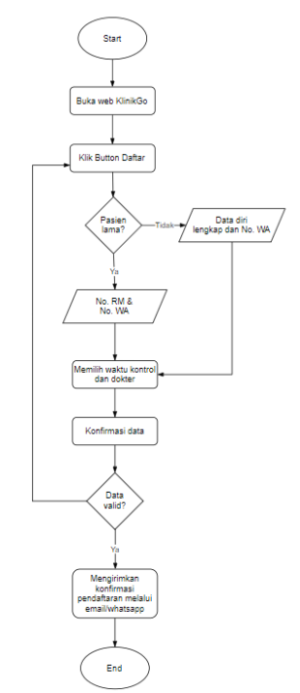
Patient Registration Flowchart
Follow the flowchart to understand the complete process of patient registration on KlinikGo. From filling out the form to confirming the appointment, every step is clearly illustrated.

Slide 6
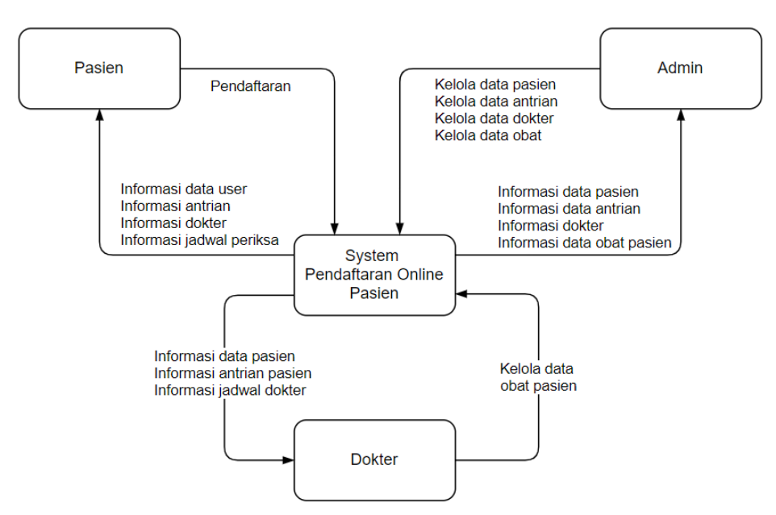
Data Flow Diagram (Level 0)
Explore the Level 0 Data Flow Diagram (DFD) of the KlinikGo patient registration system. Understand how data flows between different components to ensure a smooth registration process.

Slide 7
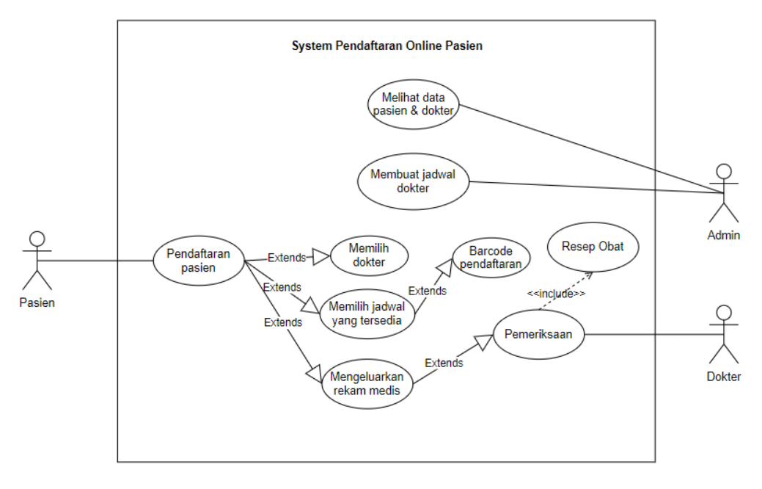
Patient Registration Use Case Diagram
Discover the Use Case Diagram that illustrates the interactions between the patient, doctor, and the KlinikGo system during the registration process. See how each party benefits from the system.

Slide 8
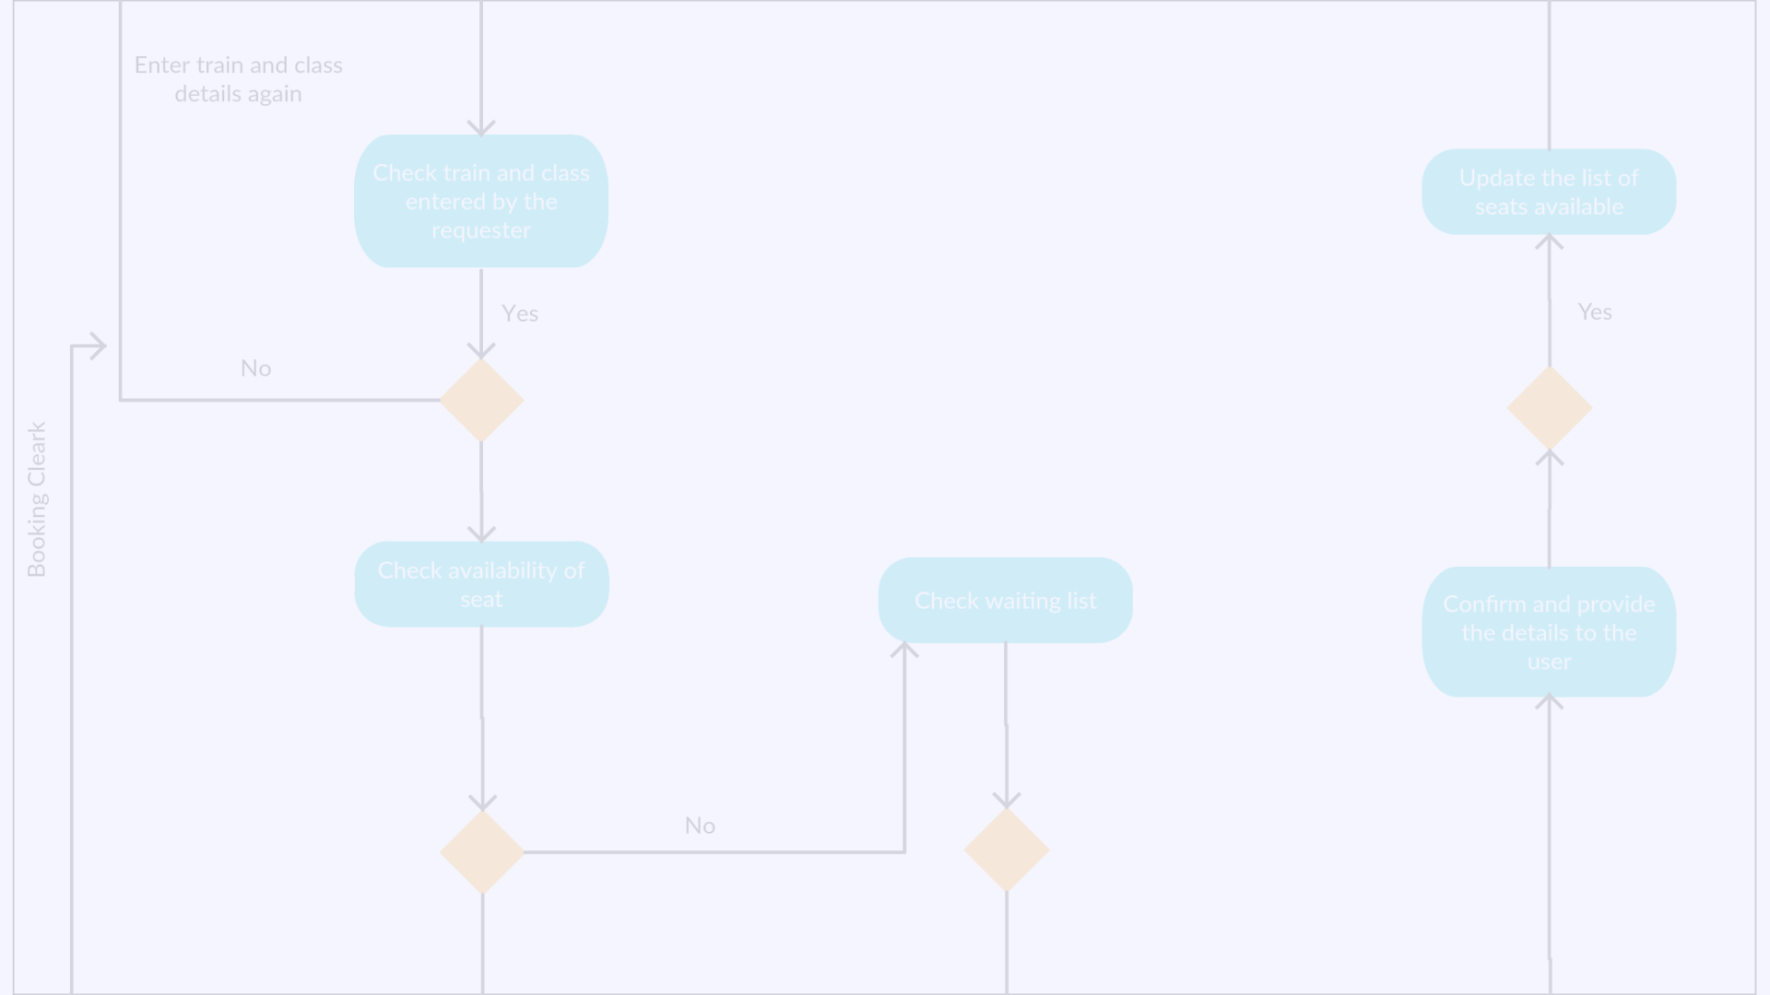
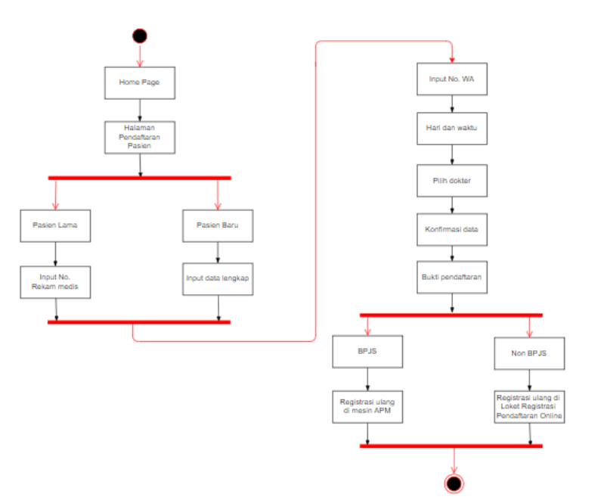
Activity Diagram for Patient Registration Process
Follow the Activity Diagram to visualize the step-by-step actions involved in the patient registration process on KlinikGo. Find out how patients navigate through the system.

Slide 9
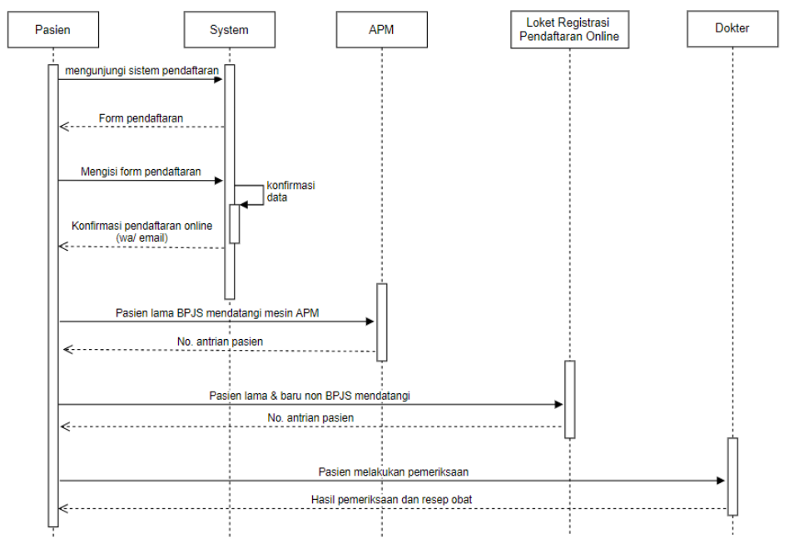
Sequence Diagram for Patient Registration Process
Explore the Sequence Diagram that depicts the chronological order of events during the patient registration process on KlinikGo. Understand the interactions between the different components.

Slide 10

Conclusion and Key Points
1
Efficiency
The online registration system saves time for both patients and healthcare providers, ensuring a streamlined experience.
2
Flexibility
Patients have the freedom to select their preferred doctor and choose an appointment time that suits their schedule.
3
User-Friendly
KlinikGo's intuitive interface makes the registration process simple and accessible for all users, regardless of their technological expertise.

Slide 11
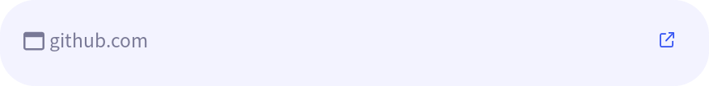
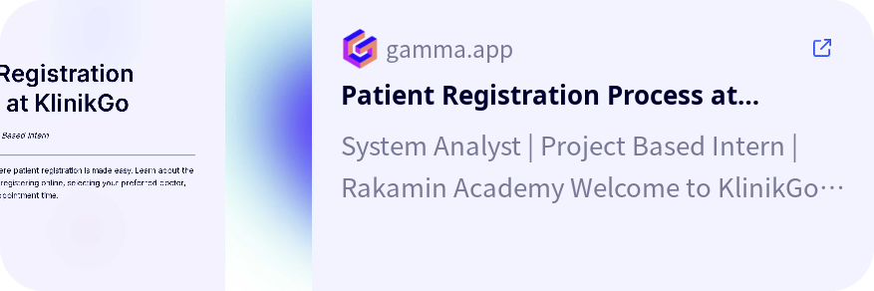
Link
Google Drive
:
https://drive.google.com/drive/folders/1ohdq9fefwg-mRh1N_SwxneZtuibmo_7n?usp=drive_link
Github
:
Slide
:

